Slide 1
Joint structure and function
Dr Payal Dhawale
Dept. Of Sports Physiotherapy
MGM Institute Of Physiotherapy
Chh. Sambhajinagar

Slide 2
Connective tissues- it connects the various tissues of the body and gives them support.
All the cells of connective (supporting) tissue are derived from mesenchymal cells. This cell is also named as undifferentiated mesenchymal cell.

Slide 3
Joint structure include many connective tissues- bones, bursae, cartilage, discs, fat pads, labra, menisci. Plates, ligaments and tendons.
4 classes of connective tissue
Connective tissue proper
Cartilage
Bone
Blood

Slide 4
Connective tissue proper
Loose connective tissue
Areolar connective tissue
Reticular tissue
Adipose tissue
Dense connective tissue
Regular
Irregular
Elastic

Slide 5
Cartilage
Hyaline
Fibrocartilage
Elastic
Bone
Compact
spongy

Slide 6
Connective tissue cell types
Two categories
fixed cells (intrinsic, in the tissue)
transient cells(within the circulatory system)

Slide 7
CELLS OF CT
Fixed cells
Transient cells
Fibroblasts
Chondroblast
Osteoblast
Osteoclast
Adipose cells
Mast cells Macrophages
Mesenchymal cell
Plasma cell
Lymphocytes
Neutrophils
Macrophage

Slide 8
Fixed cells are a resident population of cells that have developed and remain in place within the connective tissue, where they perform their functions.
The fixed cells are a stable and long-lived population that include:

Slide 9
Transient cells (free or wandering cells) originate mainly in the bone marrow and circulate in the blood stream.
Upon receiving the proper stimulus or signal, these cells leave the blood stream and migrate into the connective tissue to perform their specific function.

Slide 10
Connective tissue is characterized by widely dispersed cells and a large volume of extracellular matrix
CELLS
Fibroblast is the basic cell of most connective tissue, it produces the extracellular matrix

Slide 11
Depending on its mechanical and physiological environment, the fibroblast produces different types of connective tissue and receives a new name.
Eg chondroblast(cartilage)
Tenoblasts(tendon)
Ostoblasts (bones)

Slide 12
Extracellular matrix
Part of connective tissues outside the cells
ECM contains mainly proteins and water and is organized into fibrillar components and a surrounding matrix.

Slide 13
extracellular matrix
fibrillar
Interfibrillar
Collagen
Elastin

Slide 14
Fibrillar component –of ECM contain two major classes of structural proteins: COLLAGEN & ELASTIN.
Collagen the main substance of most connective tissues, is found in all multicellular organisms
Collagen has tensile strength responsible for the functional integrity of connective tissue structures and their resistance to tensile forces.

Slide 15
collagen
Plays an important role in tissue and organ development
It is long, rigid structure in which three polypeptides are wound around one another in a rope like fashion.
These polypeptides chains are called tropocollagen molecule.

Slide 16
collagen
They are arranged in a triple helix.
They are found everywhere in the body, but their type is dictated by their structural role in a particular organ.
Polypeptide chains are held together by hydrogen bonds.

Slide 17
Collagen
Many types of collagen have been identified, but the functions of many are not yet well understood.
The roman numerals that name each type of collagen, eg type I , type II etc…

Slide 18
collagen
Type I collagen accounts for 90% of the total collagen in the body , is found in most of the connective tissues, include tendon, ligaments, menisci, fibrocartilage, joint capsule, bones, labra, skin
Type I responsible for the tensile strength of tissue

Slide 19
collagen
Type II found mainly in cartilage and intervertebral discs.
Type III found on skin, joint capsule, muscle and tendon sheaths and in healing tissues

Slide 20
collagen
Collagen type V & XI
Cartilage, tendons

Slide 21
collagen
Filamentous type VI found in blood vessels and skin
anchoring VII anchoring filaments

Slide 22
Elastin
Found in many connective tissues, but unlike collagen, the molecule consists f single alpha-like strands without a triple helix.
Alpha like strands are cross-linked t each other to form rubber-like, elastic fibers.

Slide 23
When stretch - Each Elastin molecule uncoils into a more extended formation when fiber is stretched and recoils spontaneously when stretch force is removed.
Elastin found in all joint structure, as well as skin, the tracheobronchial tree, and the walls of arteries.

Slide 24
Elastin makes up a much smaller portion of the fibrous components in the extracellular matrix than collagen.
Aorta contains approximately 30% elastin and 20% collagen
Ligamentum nuchae has 75% elastin and 15% of collagen
Achilles tendon contains only 4.4% of elastin and 86% of collagen

Slide 25
Interfibrillar component
Interfibrillar component of connective tissue contains water & proteins, primarily glycoproteins & proteoglycans (PGs).
The interfibrillar matrix was referred to as the ground substances
Ground substance is really a mixture of PGs and water

Slide 26
GPs are found in all tissues where as PGs are found mainly in connective tissues.
The carbohydrate portion of PGs consists of long chains of repeating disaccharide units called Glycosaminoglycans (GAGs).

Slide 27
Proteoglycans (PGs)
PGS mainly found in connective tissue
PGS consist of long chains of repeating diasaccharide units called as GAGs
Attract water through GAGs
Regulate collagen fibril size
More found in tissues subjected to alternating cycles of compression.

Slide 28
The GAG chains attract water into interfibrillar matrix creating tensile stress in collagen network.
The collagen fibres resist & contain the swelling thus increasing the rigidity of ECM & resist compressive forces.
Tissues subjected to compressive forces contains more PGs & large amounts of chondroitin & keratan sulfate.
Tissues subjected to tension contains large amounts of dermatan sulfate

Slide 29
Glycosaminoglycan (GAG)
Glycosaminoglycan (GAG) chains are long, linear carbohydrate polymers.
GAGs are all very similar to glucose in structure and are distinguished by the number and location of attached amine and sulfate groups

Slide 30
Glycosaminoglycan Classification
Hyaluronic acid (does not contain any sulfate)
- exist as free GAG chain of variable length (used in OA knee to relieve symptoms )
Chondroitin sulfate -cartilage, bone
Heparan sulfate -basement membrane,component of cells surface
Heparin- intracellular granules in mast cells lining arteries
Dermatan sulfate-skin, blood vessels
Keratan sulfate -cornea, bone, cartilage often aggregated with chondroitin sulfate

Slide 31
Hyaluronan
It differs from other GAG because it is not sulfated & does not attach to protein core .
Hyaluronan exists as either free GAG chain or core molecule to which large number of PGs are attached.

Slide 32
Specific connective tissue structures
Ligaments connects one bone to another, at or near a joint
Ligaments may blend with the joint capsules and appear as thickening in the capsule
Ligaments are heterogeneous structures containing a small amount of cells(10 to 20%) and a large amount of extracellular matrix (80 to 90%)
Primarily cantain darmatan sulfate GAG.

Slide 33
The fibrillar component of the extracellular matrix in most ligament is composed of Mainly type I collagen
With lesser amount of type III, type IV, type V collagen and varying amounts of elastin

Slide 34
Exception is ligamentum flavum having large amount of elastin.
Collagen spread in multidirectional to resist forces in more than one direction.
Tendons & ligaments insert to bone via fibrocartilage or fibrous attachment & change in composition near bone is termed as Entheses.
The collagen fibres further blend into periosteum & attached to cortical bone via sharpey’s fibres.

Slide 35
Ligaments are named acc. To their shape, location, bony attachments & their relation to one another.
E.g. ant. Long.lig, MCL, LCL, coracohumeral etc.

Slide 36
tendons
Connect muscle to bone.
Usually named by the muscle e.g. biceps tendon.
Tendon contain mainly type I collagen (95%) providing greater tensile strength along with type III, IV & V.
Interfibrillar contain water, PG’s mostly dermatan sulfate & GP’s

Slide 37
Groups of fibers, enclosed by a loose connective tissue sheath is called as endotendon(bundle of fascicle) type III collagen, contains vessles
Sheath encloses the entire tendon is called epitenon
The paratenon is a double layered sheath of areolar tissue that is loosely attached to the outer surface of epitenon.
Epitenon + paratenon= peritendon
Tenndon sheath is tenosynovium

Slide 38
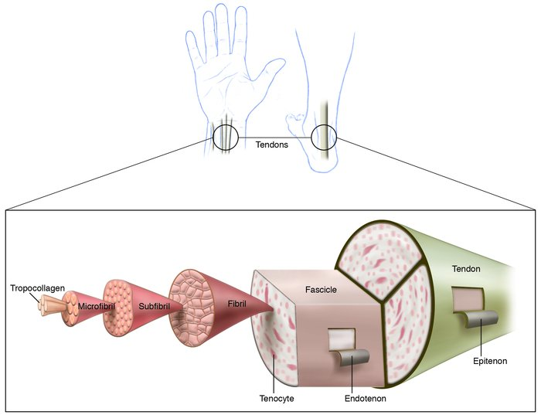

Slide 39
Bursae
Bursae are flat sacs of synovial memb. & found in tight approximation structures like tendon & bone, bone & skin, & muscle & bone.

Slide 40
Cartilage
Fibrocartilage (white)
Elastic cartilage (yellow)
Hyaline cartilage (articular)

Slide 41
Mainly contains type II, & aggregating PGs.
Fibrocartilage forms bonding cement in joints where little motion occurs. E.g. IVD, glenoid & acetabular labra, TMJ.
Yellow cartilage is found in ears, epiglottis & has more elastin.

Slide 42
Having small cellular & large ECM.
Cells are chondrocytes & chondroblasts.
Type II collagen, more of PG’s, GAG’s & hyaluronon.
Major Pg is Aggrecan contains keratan & chondrotin sulfate.

Slide 43
Chondronectin(GP) play imp. Role in adhesion of chondroblast to type II collagen
Hyaline cartilage is lacking of blood vessels , its nourishment derived from flow of synovial fluid.

Slide 44
Bones
Bone is hardest of all connective tissue.
Content:
organic fibrillar ECM mainly Type I collagen impregnated with inorganic material mainly hydroxyapatite
Fibroblast,osteoblast,osteocytes, osteoclast & progenitor cells

Slide 45
Bone has two layers,a dense outer layer and a spongier inner layer
Inner layer is called cancellous bone
Outer layer is called compact or cortical bone
Periosteum fibrous layer that covers the entire surface of each bone except the articular surface

Slide 46
At microscopic level both cortical and cancellous bone show two distinct types of bone architecture: WOVEN BONE(primary,young bone) & LAMELLAR BONE(adult skeleton)
Wolff’s law - change in bone shape to match function
Application of new forces causes osteoblast activity to increase and as a result, bone mass increases.

